Slide 1
Information Extraction
Chapter 20-20.3 J&M 3rd edition
IP disclosure: content on these slides was adapted from Ray Mooney and Ellen Riloff

Slide 2
Today’s Lecture
Information extraction
Named Entity Recognition
Relation Extraction
Temporal Expression Processing

Slide 3
Information Extraction (IE)
Identify specific pieces of information (data) in an unstructured or semi-structured textual document or speech transcription.
Transform unstructured information in a corpus of documents or web pages into a structured database.
Applied to different types of text:
Newspaper articles
Web pages
Scientific articles
Newsgroup messages
Classified ads
Medical notes

Slide 4
MUC
DARPA funded significant efforts in IE in the early to mid 1990’s.
Message Understanding Conference (MUC) was an annual event/competition where results were presented.
Focused on extracting information from news articles:
Terrorist events
Industrial joint ventures
Company management changes
Information extraction of particular interest to the intelligence community (CIA, NSA).
Established standard evaluation methodology using development (training) and test data and metrics: precision, recall, F-measure.

Slide 5
Named Entity (NE) Recognition
Specific type of information extraction in which the goal is to extract proper names of particular types of entities such as people, places, organizations, etc.
Usually a preprocessing step for subsequent task-specific IE, or other tasks such as question answering.
NEs are application specific

Slide 6
Named Entity Recognition Example
U.S. Supreme Court quashes 'illegal' Guantanamo trials
Military trials arranged by the Bush administration for detainees at Guantanamo Bay are illegal, the United States Supreme Court ruled Thursday. The court found that the trials — known as military commissions — for people detained on suspicion of terrorist activity abroad do not conform to any act of Congress. The justices also rejected the government's argument that the Geneva Conventions regarding prisoners of war do not apply to those held at Guantanamo Bay. Writing for the 5-3 majority, Justice Stephen Breyer said the White House had overstepped its powers under the U.S. Constitution. "Congress has not issued the executive a blank cheque," Breyer wrote.
President George W. Bush said he takes the ruling very seriously and would find a way to both respect the court's findings and protect the American people.

Slide 7
Named Entity Recognition Example
people places organizations
U.S. Supreme Court quashes 'illegal' Guantanamo trials
Military trials arranged by the Bush administration for detainees at Guantanamo Bay are illegal, the United States Supreme Court ruled Thursday. The court found that the trials — known as military commissions — for people detained on suspicion of terrorist activity abroad do not conform to any act of Congress. The justices also rejected the government's argument that the Geneva Conventions regarding prisoners of war do not apply to those held at Guantanamo Bay. Writing for the 5-3 majority, Justice Stephen Breyer said the White House had overstepped its powers under the U.S. Constitution. "Congress has not issued the executive a blank cheque," Breyer wrote.
President George W. Bush said he takes the ruling very seriously and would find a way to both respect the court's findings and protect the American people.

Slide 8
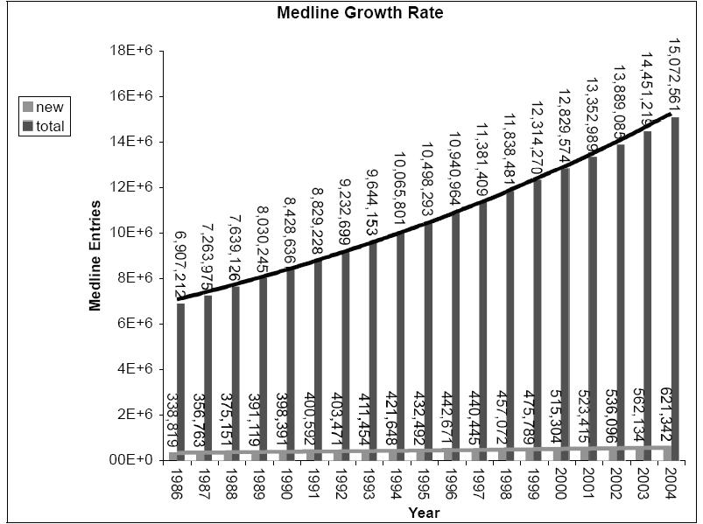
Biomedical Information Extraction

Slide 9
Medline Corpus
TI - Two potentially oncogenic cyclins, cyclin A and cyclin D1, share common properties of subunit configuration, tyrosine phosphorylation and physical association with the Rb protein
AB - Originally identified as a ‘mitotic cyclin’, cyclin A exhibits properties of growth factor sensitivity, susceptibility to viral subversion and association with a tumor-suppressor protein, properties which are indicative of an S-phase-promoting factor (SPF) as well as a candidate proto-oncogene …
Moreover, cyclin D1 was found to be phosphorylated on tyrosine residues in vivo and, like cyclin A, was readily phosphorylated by pp60c-src in vitro.
In synchronized human osteosarcoma cells, cyclin D1 is induced in early G1 and becomes associated with p9Ckshs1, a Cdk-binding subunit.
Immunoprecipitation experiments with human osteosarcoma cells and Ewing’s sarcoma cells demonstrated that cyclin D1 is associated with both p34cdc2 and p33cdk2, and that cyclin D1 immune complexes exhibit appreciable histone H1 kinase activity …

Slide 10
Medline Corpus: Named Entity Recognition (Proteins)
TI - Two potentially oncogenic cyclins, cyclin A and cyclin D1, share common properties of subunit configuration, tyrosine phosphorylation and physical association with the Rb protein
AB - Originally identified as a ‘mitotic cyclin’, cyclin A exhibits properties of growth factor sensitivity, susceptibility to viral subversion and association with a tumor-suppressor protein, properties which are indicative of an S-phase-promoting factor (SPF) as well as a candidate proto-oncogene …
Moreover, cyclin D1 was found to be phosphorylated on tyrosine residues in vivo and, like cyclin A, was readily phosphorylated by pp60c-src in vitro.
In synchronized human osteosarcoma cells, cyclin D1 is induced in early G1 and becomes associated with p9Ckshs1, a Cdk-binding subunit.
Immunoprecipitation experiments with human osteosarcoma cells and Ewing’s sarcoma cells demonstrated that cyclin D1 is associated with both p34cdc2 and p33cdk2, and that cyclin D1 immune complexes exhibit appreciable histone H1 kinase activity …

Slide 11
Amazon Book Description
….
</td></tr>
</table>
<b class="sans">The Age of Spiritual Machines : When Computers Exceed Human Intelligence</b><br>
<font face=verdana,arial,helvetica size=-1>
by <a href="/exec/obidos/search-handle-url/index=books&field-author=
Kurzweil%2C%20Ray/002-6235079-4593641">
Ray Kurzweil</a><br>
</font>
<br>
<a href="http://images.amazon.com/images/P/0140282025.01.LZZZZZZZ.jpg">
<img src="http://images.amazon.com/images/P/0140282025.01.MZZZZZZZ.gif" width=90
height=140 align=left border=0></a>
<font face=verdana,arial,helvetica size=-1>
<span class="small">
<span class="small">
<b>List Price:</b> <span class=listprice>$14.95</span><br>
<b>Our Price: <font color=#990000>$11.96</font></b><br>
<b>You Save:</b> <font color=#990000><b>$2.99 </b>
(20%)</font><br>
</span>
<p> <br>
….
</td></tr>
</table>
<b class="sans">The Age of Spiritual Machines : When Computers Exceed Human Intelligence</b><br>
<font face=verdana,arial,helvetica size=-1>
by <a href="/exec/obidos/search-handle-url/index=books&field-author=
Kurzweil%2C%20Ray/002-6235079-4593641">
Ray Kurzweil</a><br>
</font>
<br>
<a href="http://images.amazon.com/images/P/0140282025.01.LZZZZZZZ.jpg">
<img src="http://images.amazon.com/images/P/0140282025.01.MZZZZZZZ.gif" width=90
height=140 align=left border=0></a>
<font face=verdana,arial,helvetica size=-1>
<span class="small">
<span class="small">
<b>List Price:</b> <span class=listprice>$14.95</span><br>
<b>Our Price: <font color=#990000>$11.96</font></b><br>
<b>You Save:</b> <font color=#990000><b>$2.99 </b>
(20%)</font><br>
</span>
<p> <br>…

Slide 12
Extracted Book Template
Title: The Age of Spiritual Machines :
When Computers Exceed Human Intelligence
Author: Ray Kurzweil
List-Price: $14.95
Price: $11.96
:
:

Slide 13
Other Applications
Job postings
Job resumes
Seminar announcements
Company information from the web
Continuing education course info from the web
University information from the web
Apartment rental ads
Molecular biology information from MEDLINE

Slide 14
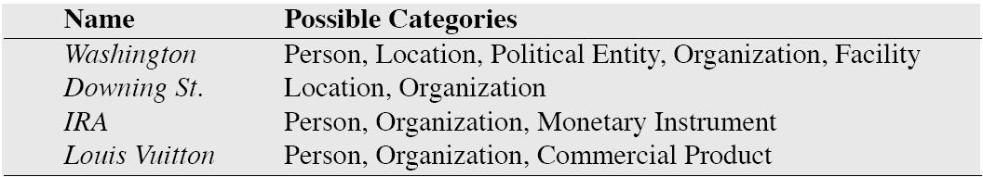
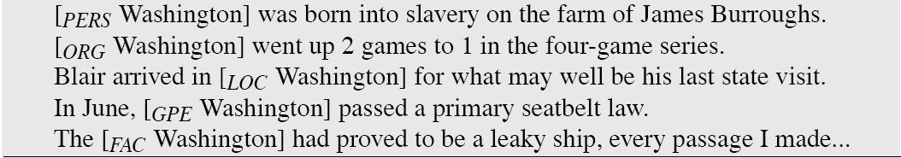
How Difficult is NER?

Slide 15
IE as Sequence Labeling
Can extract features describing each token in the text.
Can apply a sliding window classifier using various classification algorithms.
Can apply probabilistic sequence models:
HMM
CRF (Conditional Random Fields)

Slide 16
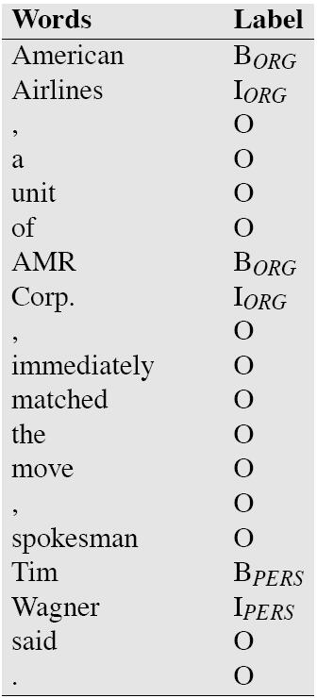
Sequence Labeling for NER
Typical features
Lexical items
Shape features
Gazetteers
Stemmed lexical item
POS
Trigger words

Slide 17
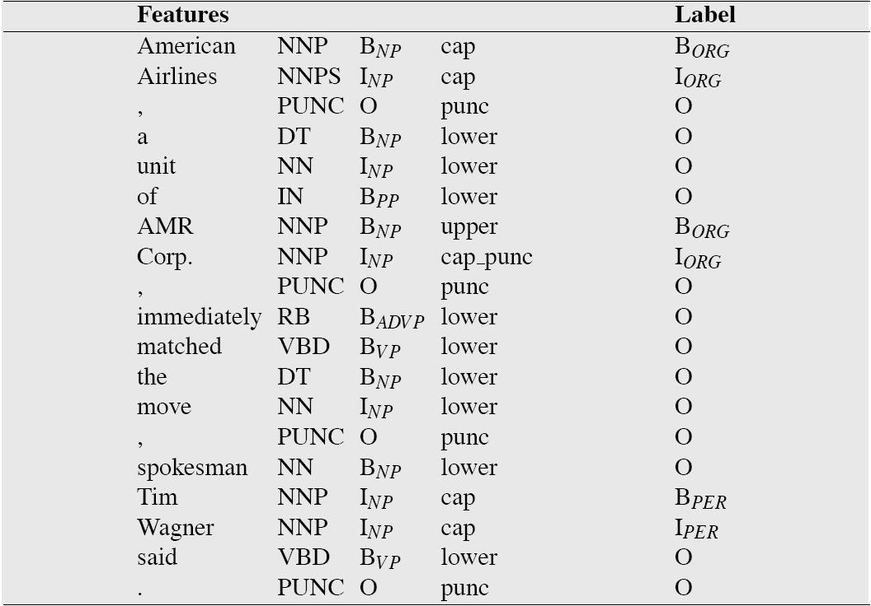
Sequence Labeling for NER

Slide 18
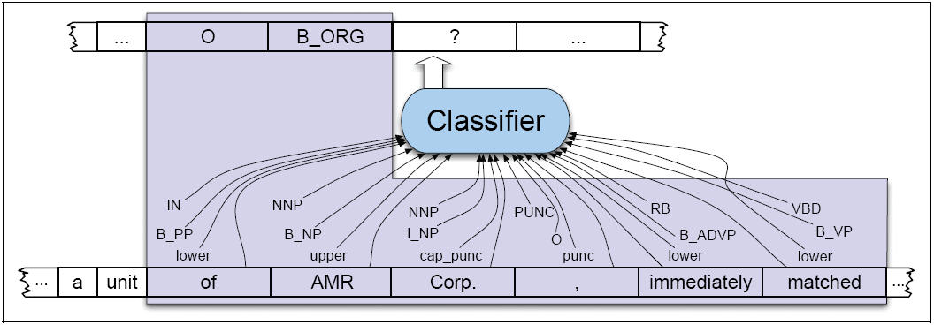
Sequence Labeling for NER

Slide 19
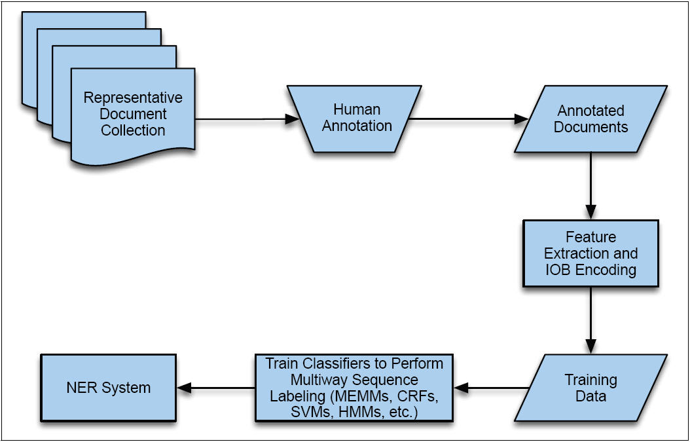
Sequence Labeling for NER
Commercial systems are more complex, often including several iterations over the data

Slide 20
Evaluating IE Accuracy
Always evaluate performance on independent, manually-annotated test data not used during system development.
Measure for each test document:
Total number of NEs in the solution template: N
Total number of NEs extracted by the system: E
Number of extracted NEs that are correct (i.e. in the gold standard): C
Compute average value of metrics adapted from IR:
Recall = C/N
Precision = C/E
F-Measure = Harmonic mean of recall and precision
2 x Precision x Recall / (Precision + Recall)

Slide 21
Relation Extraction

Slide 22
Relation Extraction
Once entities are recognized, identify specific relations between entities
Employed-by
Located-at
Part-of
Example:
Michael Dell is the CEO of Dell Computer Corporation and lives in Austin Texas.

Slide 23
Medline Corpus: Relation Extraction Protein Interactions
TI - Two potentially oncogenic cyclins, cyclin A and cyclin D1, share common properties of subunit configuration, tyrosine phosphorylation and physical association with the Rb protein
AB - Originally identified as a ‘mitotic cyclin’, cyclin A exhibits properties of growth factor sensitivity, susceptibility to viral subversion and association with a tumor-suppressor protein, properties which are indicative of an S-phase-promoting factor (SPF) as well as a candidate proto-oncogene …
Moreover, cyclin D1 was found to be phosphorylated on tyrosine residues in vivo and, like cyclin A, was readily phosphorylated by pp60c-src in vitro.
In synchronized human osteosarcoma cells, cyclin D1 is induced in early G1 and becomes associated with p9Ckshs1, a Cdk-binding subunit.
Immunoprecipitation experiments with human osteosarcoma cells and Ewing’s sarcoma cells demonstrated that cyclin D1 is associated with both p34cdc2 and p33cdk2, and that cyclin D1 immune complexes exhibit appreciable histone H1 kinase activity …

Slide 24
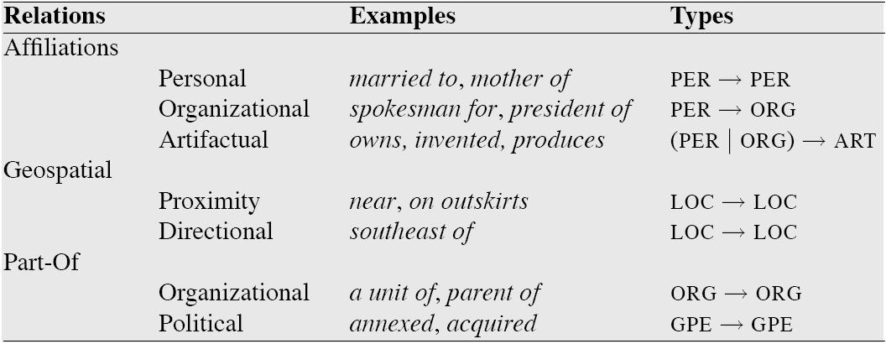
Relation Extraction
The goal is to identify a set of ordered tuples over elements of a domain.

Slide 25
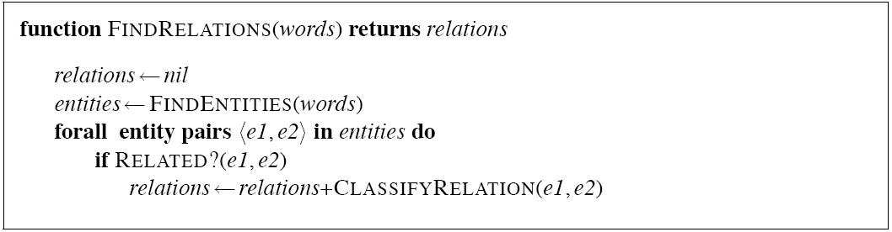
Supervised Learning for Relation Extraction

Slide 26
Supervised Learning for Relation Extraction
Features commonly used include:
NE types
Bag of words for each argument
Headwords of the arguments
Bag of words and bigrams between entities
Stemmed versions
Words and stems in the immediate context
Presence of particular constructions
Chunk based-phrase paths
Constituent-tree paths

Slide 27
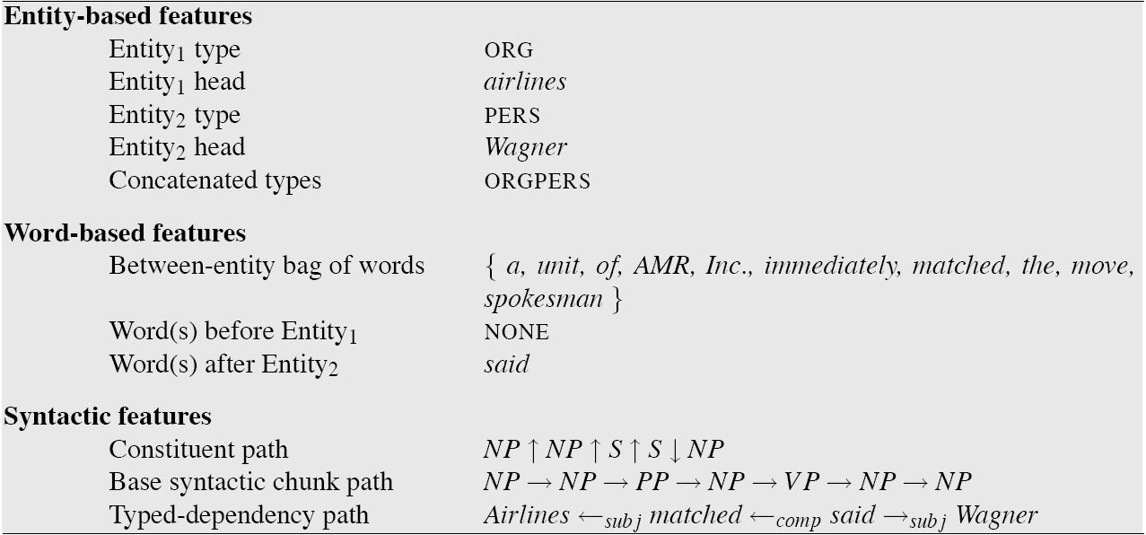
Supervised Learning for Relation Extraction

Slide 28
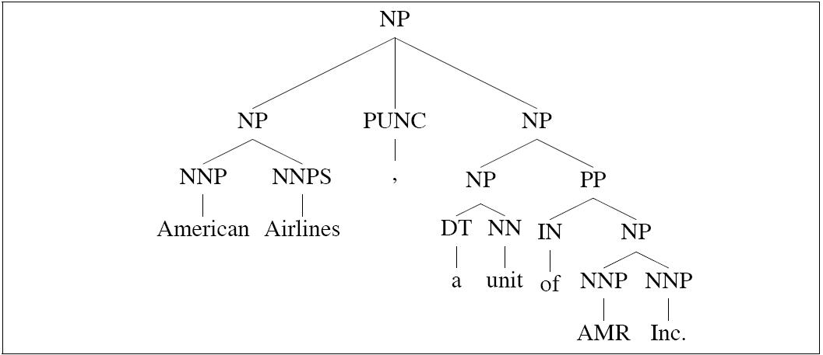
Syntactic Features for Supervised Learning for Relation Extraction
Example of an appositive construction

Slide 29
Lightly Supervised Relation Extraction
We can use regular expressions to mine the web for relations:
* is the Capital of *
Will return the following examples:
Cairo is the Capital of Egypt
Madrid is the Capital of Spain
But also:
New York City is the Capital of the World
Harlem is the Capital of every Ghetto in Town
Are we missing something?

Slide 30
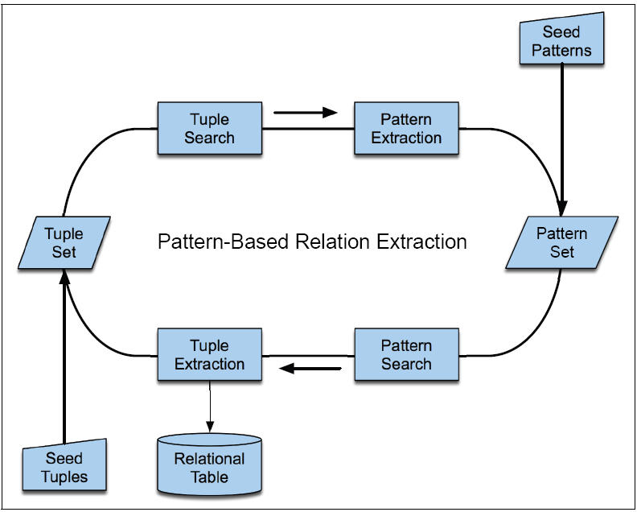
Lightly Supervised Relation Extraction
-[LOC] is [LOC]’s Capital
-[LOC] the Capital of [LOC]
-[LOC], [LOC]’s Capital City
-Cairo is Egypt’s Capital
-Cairo the Capital of Egypt
-Cairo, Egypt’s Capital City
Cairo, Capital, Egypt

Slide 31
Lightly Supervised Relation Extraction
We need to address the following problems:
Representation of the search patterns
Assessing accuracy and coverage of discovered patterns
(Riloff and Jones, 1999)
Assessing reliability of discovered tuples

Slide 32
Evaluation of Relation Extraction Systems
Can focus on:
Measuring relation extraction (can use labeled or unlabeled recall, precision and f-measure)
Measuring how much the system can discover (humans analyze the output of the system and compute accuracy, no recall)
Use external sources such as gazetteers to measure recall

Slide 33
Temporal Expression Recognition

Slide 34
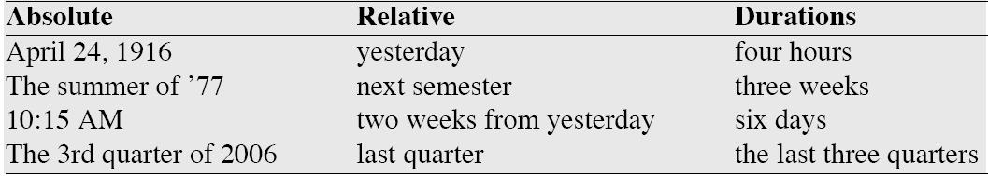
Temporal Expression Recognition
Types of temporal expressions

Slide 35
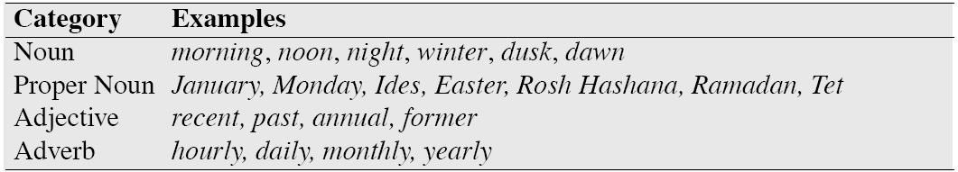
Temporal Expression Recognition
Examples of lexical triggers

Slide 36
Temporal Expression Recognition
Annotation scheme
A fare increase initiated <TIMEX3>last week </TIMEX3> by UAL Corp’s United Airlines was matched by competitors over <TIMEX3>the weekend </TIMEX3>, marking the second successful fare increase in <TIMEX3>two weeks </TIMEX3>.

Slide 37
Temporal Expression Recognition
Approaches:
Rule-based systems
Sequence labeling systems
Constituent based classification

Slide 38
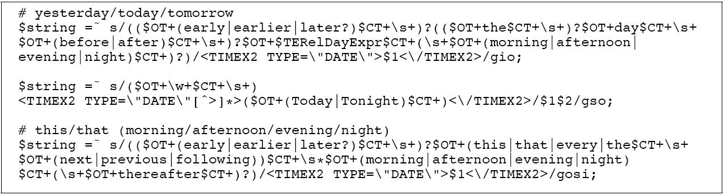
Rule-based Systems for Temporal Expression Recognition

Slide 39
Sequence Labeling Systems for Temporal Expression Recognition
Use the same I,O,B scheme to train a classification algorithm:
A fare increase initiated last week by UAL Corp’s
O O O O B I O O O

Slide 40
Constituent Based Approaches
Give the segmentation task to the syntactic parser
Train binary classifiers on chunks

Slide 41
Evaluation of Temporal Expression Recognition
Standard measures: precision, recall, and f-measure
Best systems are at ~.87 (labeled p, and r)

Slide 42
Temporal Processing
Ambiguities from trigger words:
I was listening to Manic Monday on the radio
After extraction of temporal expressions we need to do normalization.

Slide 43
Information Extraction Issues
Better active learning methods
Integrating entity and relation extraction
Semi-supervised IE
Adaptation and transfer to new tasks
Mining extracted data to find cross-document regularities.

